Slide 1




PYTHON
DEVELOPMENT INTERNSHIP
at Amivir Infotech
Internal Presentation
20C0S38 SAMIRALI MUKHI

Slide 2

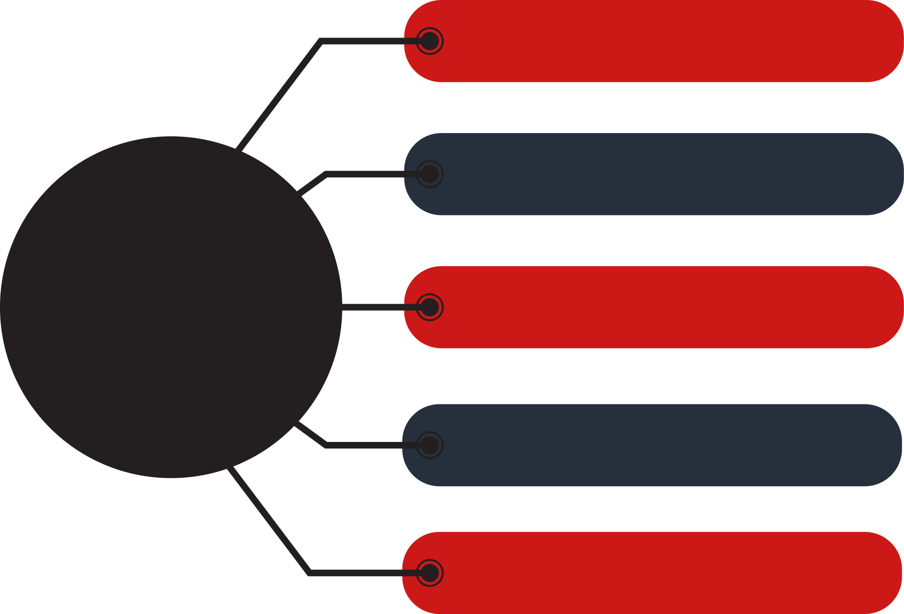


AGENDA
I have done training sessions focused on advanced Python concepts and relevant libraries. The training cover topics such as object-oriented programming, file handling, data structures, and popular Python libraries.
Week 1: Training Phase
They assigned specific tasks related to Python development. These tasks will be designed to reinforce my learning from the training sessions and provide practical experience in implementing Python solutions.
Week 2 & 3: Task Assignment
Week 4 - 7: Library Management System
For the remaining weeks of the internship, I will be working on a real-world project, which is the development of a Library Management System. The project will involve designing and implementing a web application using Flask or Django framework. I will be responsible for the end-to-end development of this project, including planning, coding, testing, and documentation.
Development Phase
Development Phase

Slide 3
PROJECT DEFINITION
The Library Management System project is a comprehensive web application designed to streamline and automate various processes involved in managing a library. It aims to provide librarians and library staff with a user-friendly platform to efficiently handle tasks such as cataloging books, tracking book availability, feedback, and group chat.
The project focuses on creating a centralized database that stores information about books, users, and transactions, as well as managing user accounts, monitoring book circulation, feedback, and group chat. The system aims to improve the overall efficiency, accuracy, and accessibility of library operations, enhancing the user experience for both librarians and library patrons.

Slide 4


TECHNOLOGY DESCRIPTION
Django Framework
The project leverages Django, a popular Python web framework known for its simplicity, flexibility, and extensive feature sets. These frameworks provide the foundation for building web applications and offer tools for handling routing, data management, user authentication, and template rendering.
HTML/CSS/JavaScript
Front-end technologies like HTML, CSS, and JavaScript are used to create an intuitive and visually appealing user interface. These technologies handle the presentation layer, allowing users to interact with the system, search for books, view their account information, and perform various actions.

Slide 5
ROLES & RESPONSIBILITIES
As an intern, my role and responsibilities for the project will involve active participation in the development process and contributing to the successful completion of the Library Management System project.
Project Development:
Collaborate with the project team to understand the requirements and objectives of the Library Management System project.
Contribute to the overall design and architecture of the system under the guidance of mentors and project leads.
Communication and Collaboration:
Maintain effective communication with a mentor, project leads, and other team members.
Attend regular meetings and discussions to share progress, updates, and challenges faced during the development process
Documentation:
Document code, including relevant comments and documentation, to facilitate future maintenance and understanding by others

Slide 6
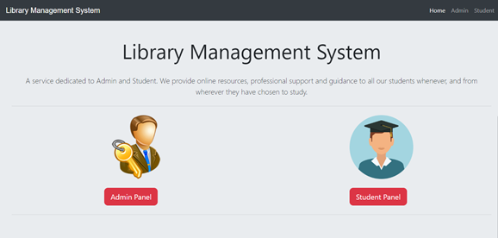
SCREENSHOTS OF WORK DONE

Slide 7
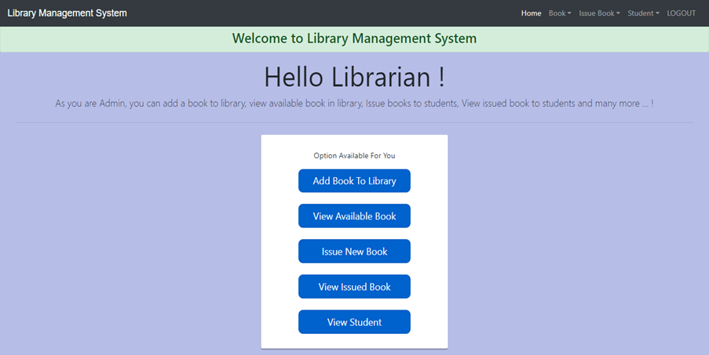
SCREENSHOTS OF WORK DONE

Slide 8
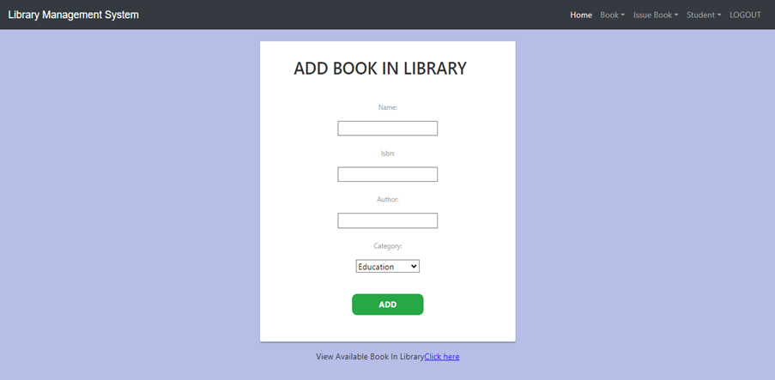
SCREENSHOTS OF WORK DONE

Slide 9
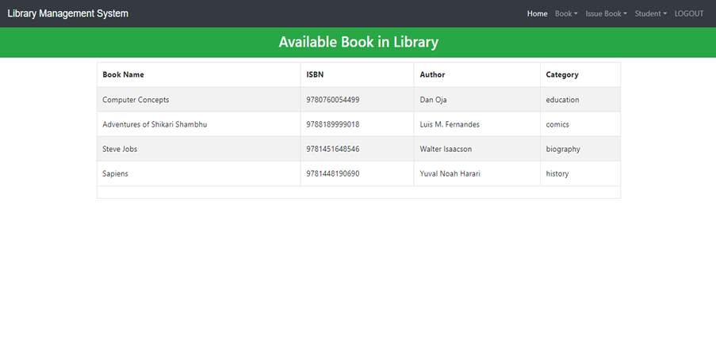
SCREENSHOTS OF WORK DONE

Slide 10
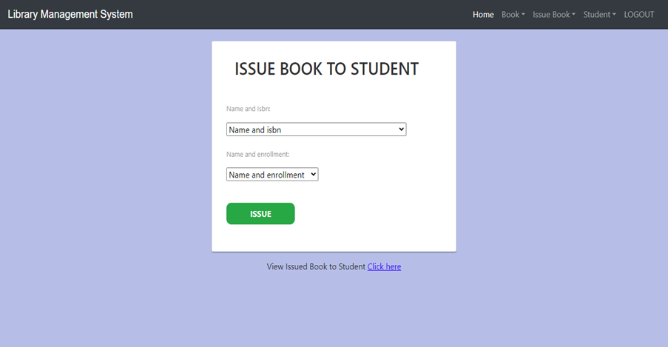
SCREENSHOTS OF WORK DONE

Slide 11
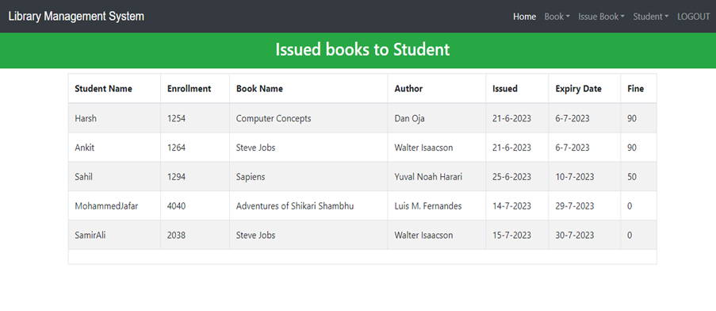
SCREENSHOTS OF WORK DONE

Slide 12
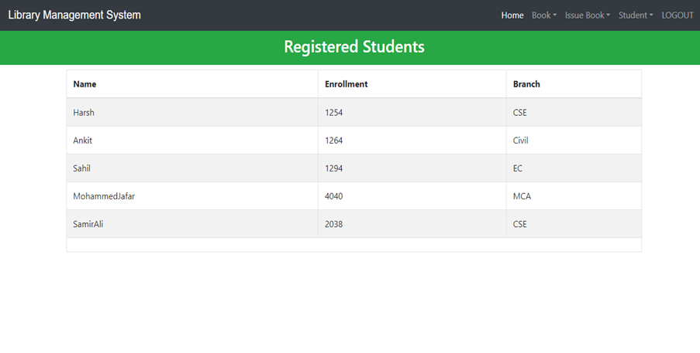
SCREENSHOTS OF WORK DONE

Slide 13
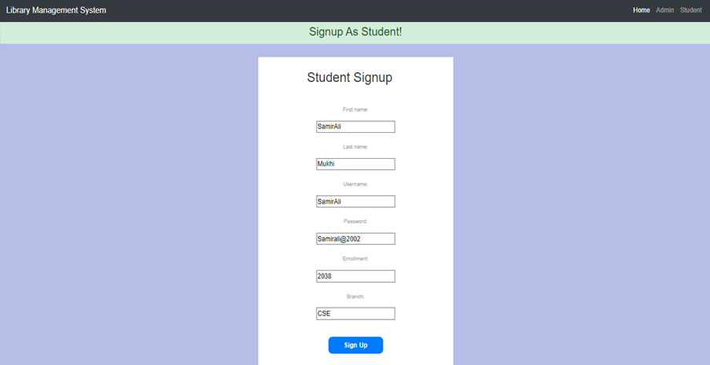
SCREENSHOTS OF WORK DONE

Slide 14
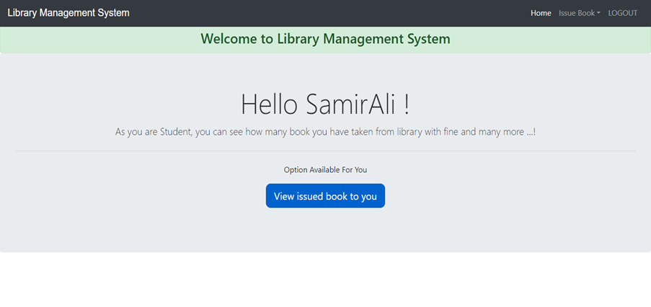
SCREENSHOTS OF WORK DONE

Slide 15
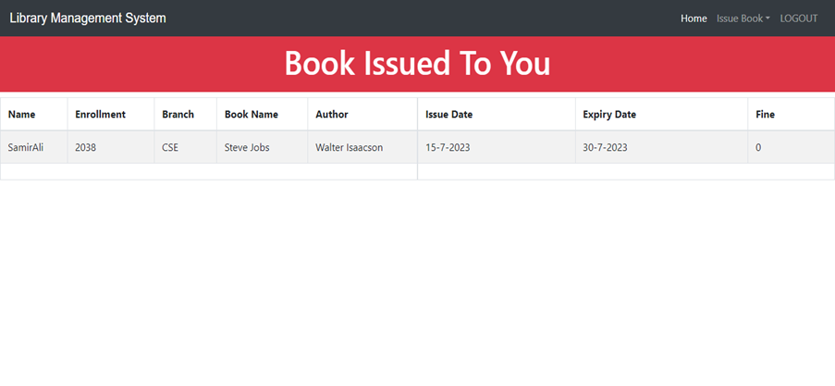
SCREENSHOTS OF WORK DONE

Slide 16
ADVANTAGES OF TAKING AN INTERNSHIP
Practical Learning: Internships provide an opportunity to apply theoretical knowledge to real-world scenarios, bridging the gap between academia and industry. Through hands-on experience, I gain practical skills that are valuable in my future career.
Industry Exposure: Internships expose the professional work environment and industry practices. I get a firsthand experience of the industry culture, work ethics, and standards, helping me adapt and prepare for future employment.
Skill Development: Internships allow me to develop and enhance various skills required in the professional world. I can improve technical skills specific to my field, as well as soft skills such as communication, teamwork, problem-solving, and time management.
Overall, internships provide a platform for personal and professional growth, offering valuable experiences, skill development, and networking opportunities. They play a crucial role in shaping my career path and preparing me for the challenges and opportunities in the professional world.

Slide 17

Thank You
20CS038 SAMIRALI

